Slide 1
Chapter 1
Introduction to Computers
Objectives
❏ To review basic computer systems concepts
❏ To be able to understand the different computing environments and their components
❏ To review the history of computer languages
❏ To be able to list and describe the classifications of computer languages
❏ To understand the steps in the development of a computer program
❏ To review the system development life cycle

Slide 2
1-1 Computer Systems
Today computer systems are found everywhere. Computers have become almost as common as televisions. But what is a computer? A computer is a system made of two major components: hardware and software.
Topics discussed in this section:
Computer Hardware
Computer Software

Slide 3
FIGURE 1-1 A Computer System

Slide 4
FIGURE 1-2 Basic Hardware Components

Slide 5
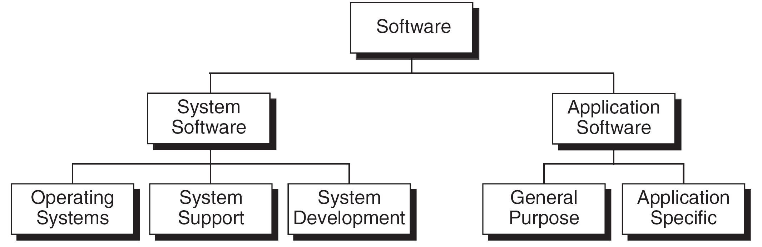
FIGURE 1-3 Types of Software

Slide 6
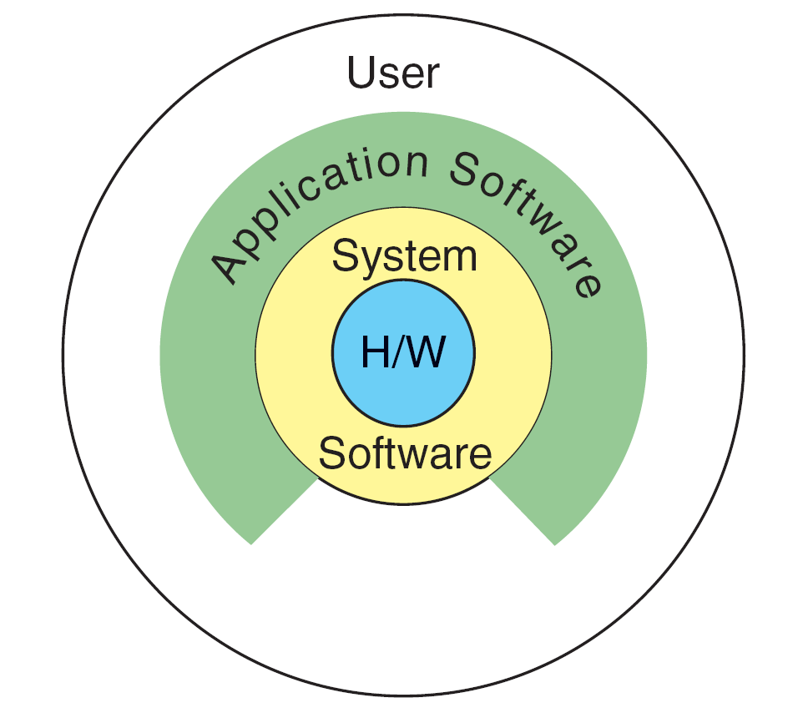
FIGURE 1-4 Relationship between system and application software

Slide 7
1-2 Computing Environments
In the early days of computers, there was only one environment, the mainframe computer hidden in a central computing department. With the advent of minicomputers and personal computers, the environment changed with computers on virtually every desktop. In this section we describe several different environments.
Topics discussed in this section:
Personal Computing Environment
Time-Sharing Environment
Client/Server Environment Distributed Computing

Slide 8
FIGURE 1-5 Personal Computing Environment

Slide 9
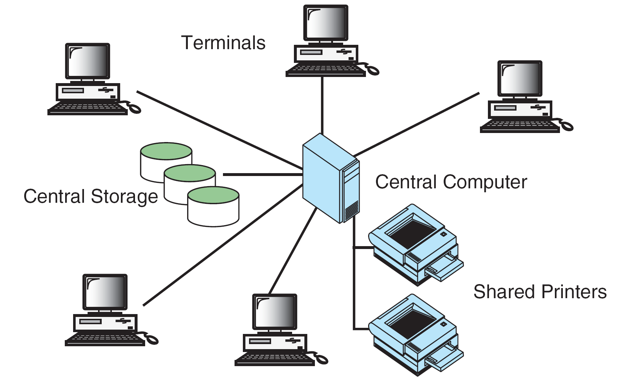
FIGURE 1-6 Time-sharing Environment

Slide 10
FIGURE 1-7 The Client/Server Environment

Slide 11
FIGURE 1-8 Distributed Computing

Slide 12
1-3 Computer Languages
To write a program for a computer, we must use a computer language. Over the years computer languages have evolved from machine language to natural languages.
Topics discussed in this section:
Machine Languages
Symbolic Languages High-Level Languages

Slide 13
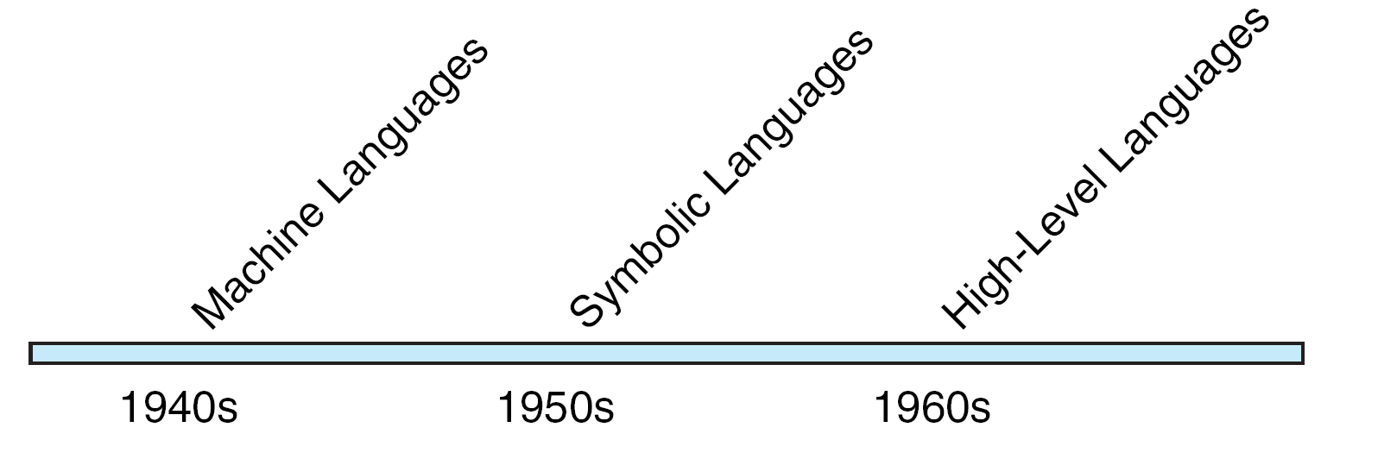
FIGURE 1-9 Computer Language Evolution

Slide 14
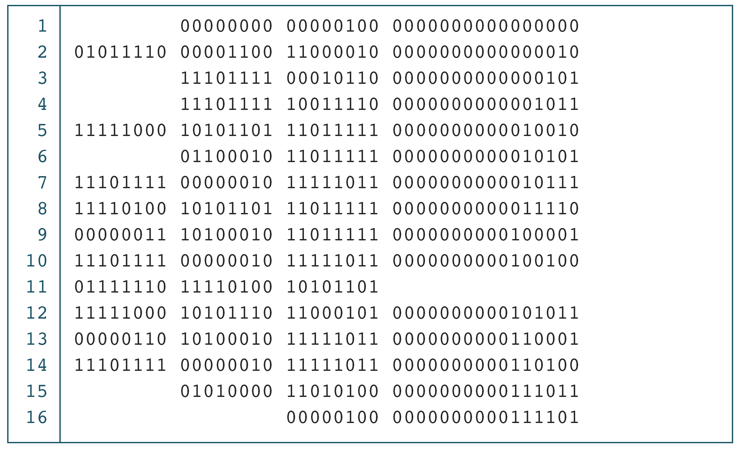
PROGRAM 1-1
The Multiplication Program in Machine Language

Slide 15
Note
The only language understood by computer
hardware is machine language.

Slide 16
PROGRAM 1-2
The Multiplication Program in Symbolic Language

Slide 17
Note
Symbolic language uses symbols, or mnemonics, to represent the various machine language instructions.

Slide 18
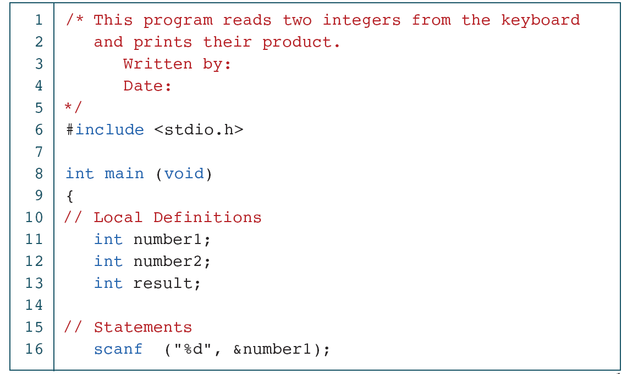
PROGRAM 1-3
The Multiplication Program in C
continued

Slide 19
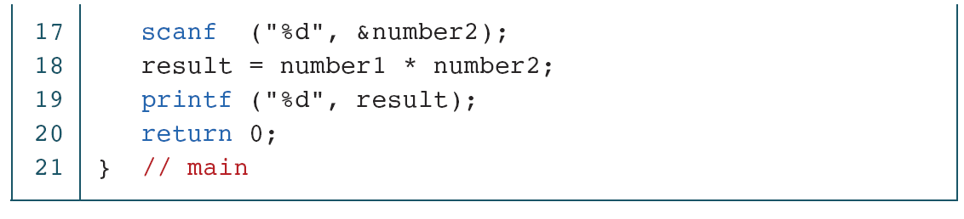
PROGRAM 1-3
The Multiplication Program in C (continued)

Slide 20
1-4 Creating and Running Programs
In this section, we explain the procedure for turning a program written in C into machine language. The process is presented in a straightforward, linear fashion, but you should recognize that these steps are repeated many times during development to correct errors and make improvements to the code.
Topics discussed in this section:
Writing and Editing Programs Compiling Programs Linking Programs Executing Programs

Slide 21
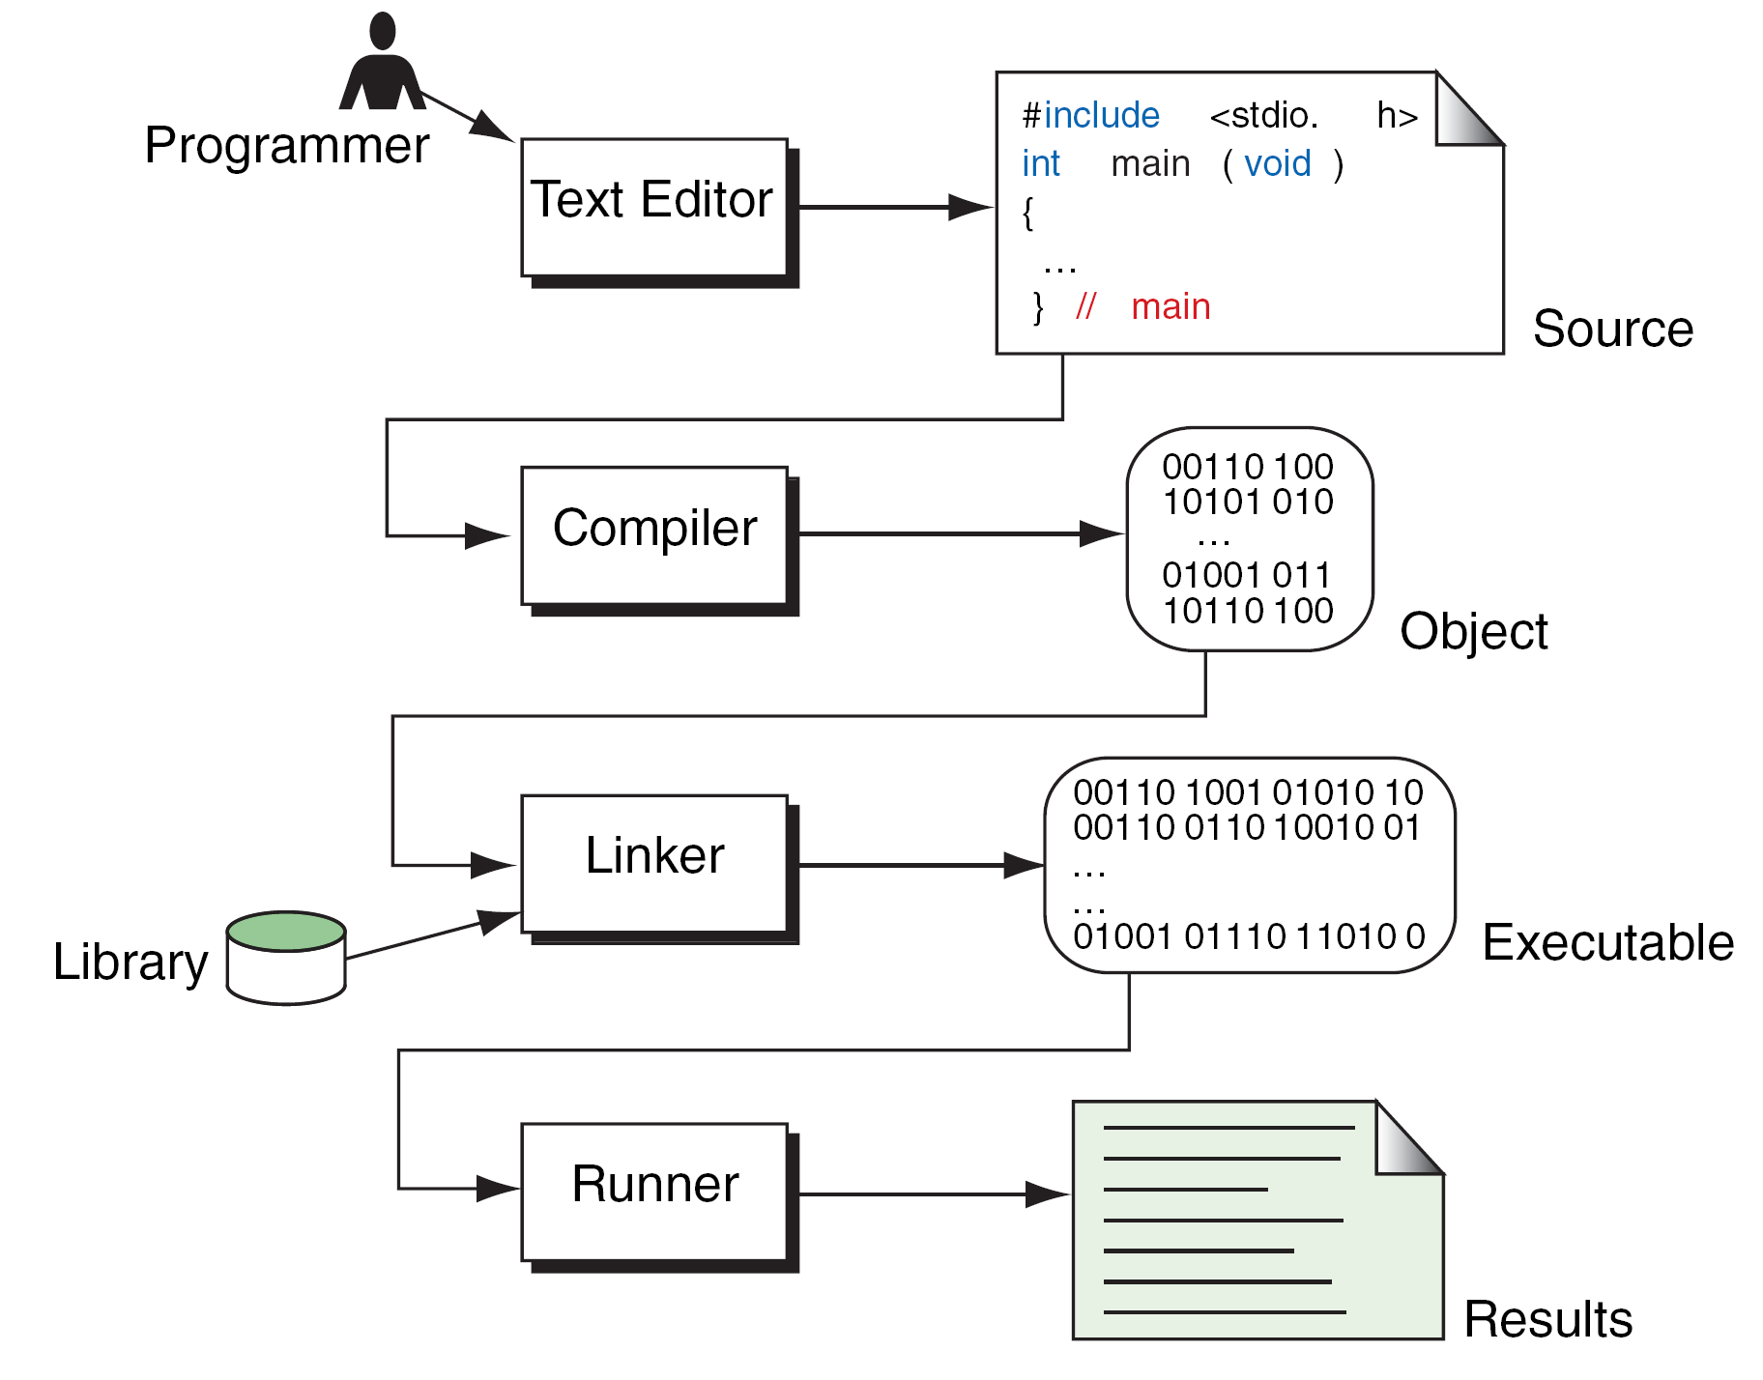
FIGURE 1-10 Building a C Program

Slide 22
1-5 System Development
We’ve now seen the steps that are necessary to build a program. In this section, we discuss how we go about developing a program. This critical process determines the overall quality and success of our program. If we carefully design each program using good structured development techniques, our programs will be efficient, error-free, and easy to maintain.
Topics discussed in this section:
System Development Life Cycle
Program Development

Slide 23
FIGURE 1-11 Waterfall Model

Slide 24
Note
An old programming proverb:
Resist the temptation to code.

Slide 25
FIGURE 1-12 Structure Chart for Calculating Square Footage

Slide 26
Note
Pseudocode
English-like statements that follow a loosely defined syntax and are used to convey the design of an algorithm.

Slide 27
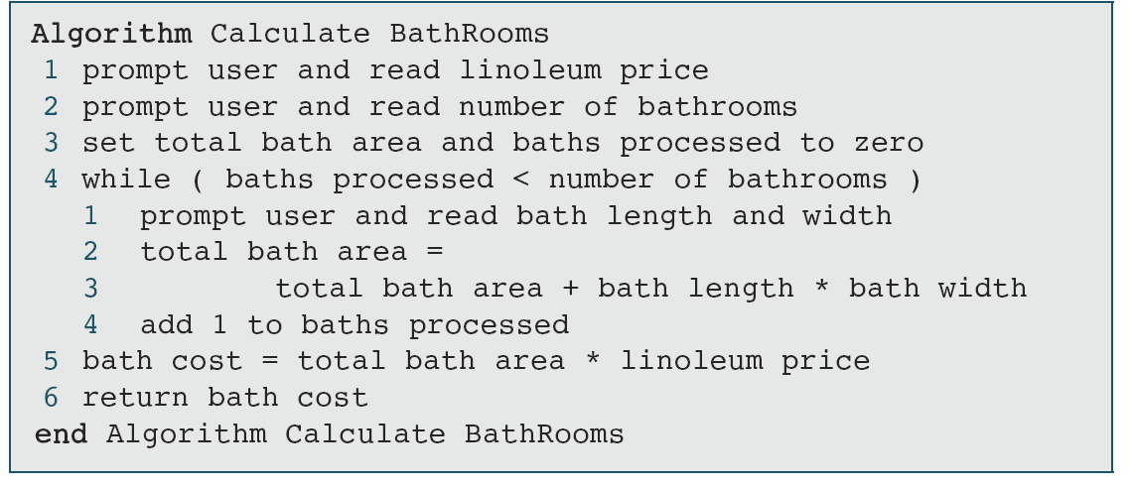
ALGORITHM 1-1
Pseudocode for Calculate Bathrooms

Slide 28
FIGURE 1-13 Flowchart for Calculate Bathrooms

Slide 29
Note
Except for the most simple program, one set of
test data will not completely validate a program.

Slide 30
1-6 Software Engineering
Software engineering is the establishment and use of sound engineering methods and principles to obtain software that is reliable and that works on real machines. This definition, from the first international conference on software engineering in 1969, was proposed 30 years after the first computer was built. During that period, software was more of an art than a science.

